Slide 1
Python Explained 2

Slide 2
Content
Conventions
Dictionaries
Sets

Slide 3
Conventions – Global vs Local Variables
Global
Local
Defined outside of a function
Accessible from any part of the code, including inside functions
Can be modified using the ‘global keyword’
Defined inside a function
Accessible only within the function where they are defined
Changes made to local variables inside a function do not affect variables outside the function

Slide 4
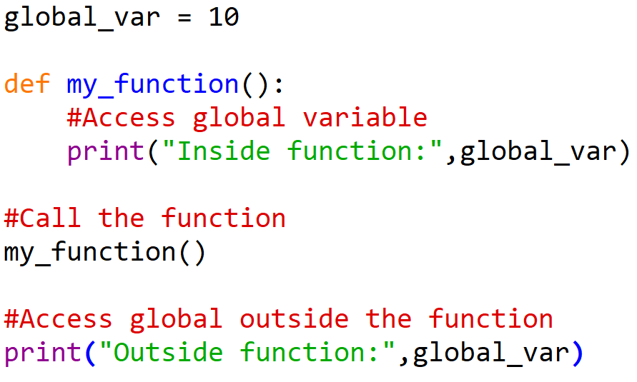

Conventions – Global Example

Slide 5
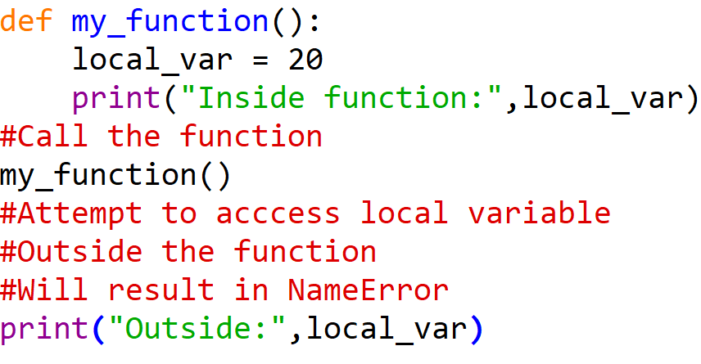
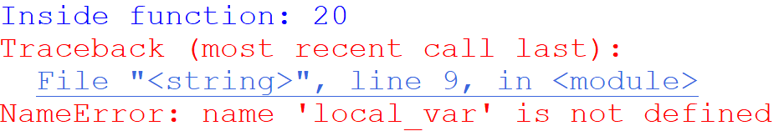
Conventions – Local Example

Slide 6
Conventions – Mathematical Operators
Explicit is always better than implicit
Example
Both I += 1 and I = I + 1 increment by 1
Whilst the former is shorthand for incrementing by 1 and the latter is the long form
Produce the same result, subtle difference how they work
Use I = I + 1 for understanding
Clarity – explicitly shows the process by incrementing by 1
Understanding – Longer form helps when checking your code
Transparency – Provides clear view of assignment operation (=) and addition operation (+)

Slide 7
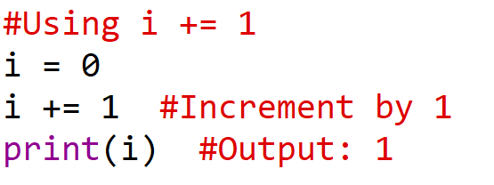
Conventions – Math -> Example 1

Slide 8
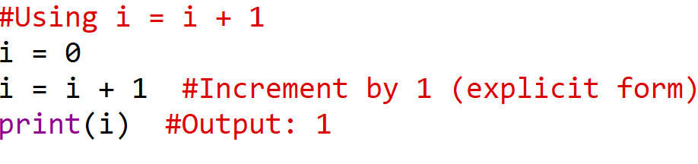
Conventions – Math -> Example 2

Slide 9
Dictionaries - Introduction
Built-in data type used to store collections of data in key-value pairs
Unlike sequences that store elements by index, dictionaries tore elements by keys
Key characteristics
Key-Value Pairs – Each key is unique and associated with a value
Mutable – Can be modified after creation by adding, removing or updating pairs
Unordered – Order of elements is not guaranteed

Slide 10
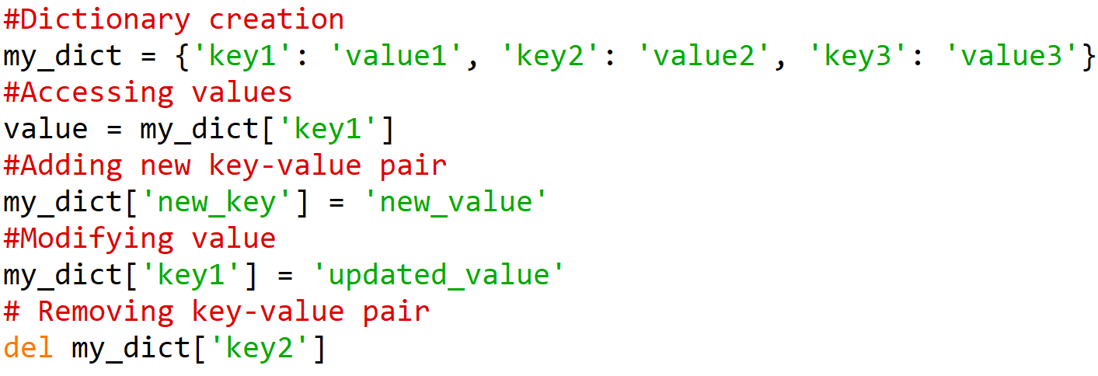
Dictionaries – Syntax Example

Slide 11
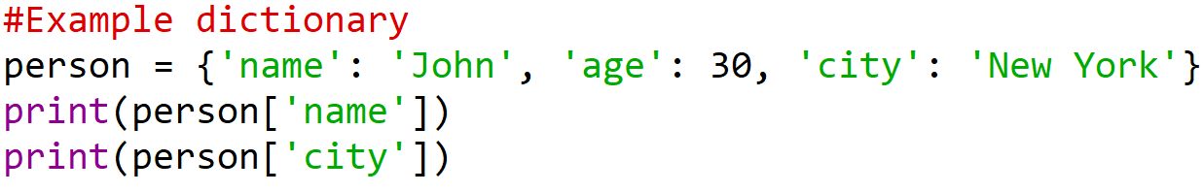
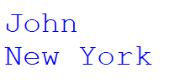
Dictionaries – Storage Example

Slide 12
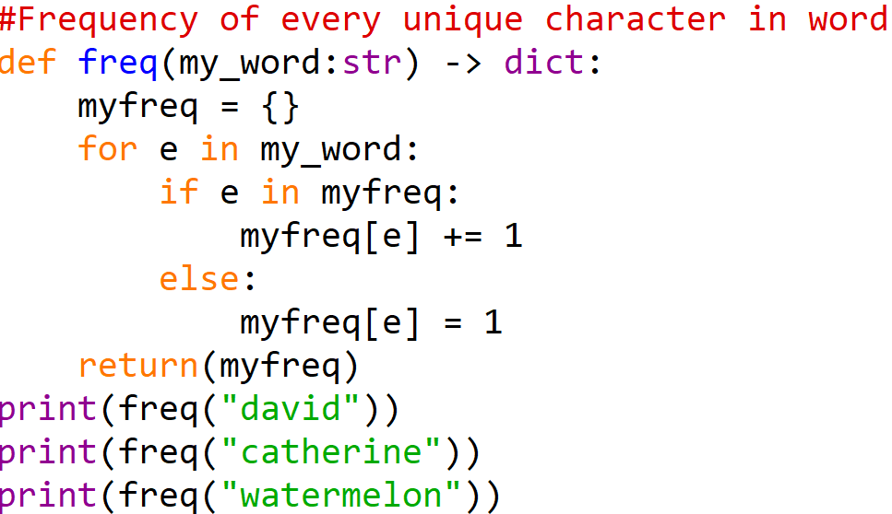
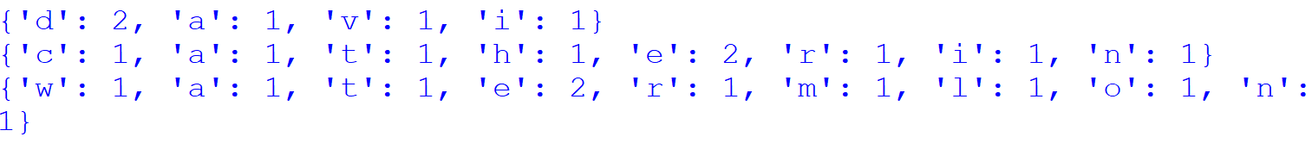
Dictionaries - Frequency

Slide 13
Sets - Introduction
Built-in data type used to store collections of unique elements and function finds unique elements in list
Do not allow duplicate elements and they are unordered
Key characteristics:
Uniqueness – Only contain unique elements, duplicate elements ignored
Unordered – Do not maintain order of elements inserted
Mutability – You can add or remove elements after creation

Slide 14
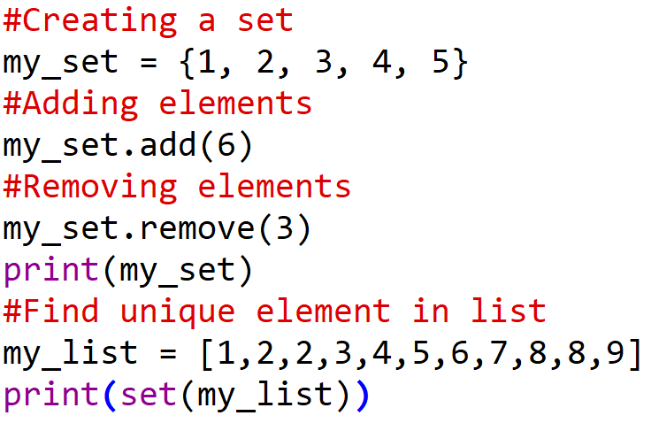

Sets – Syntax Example

Slide 15
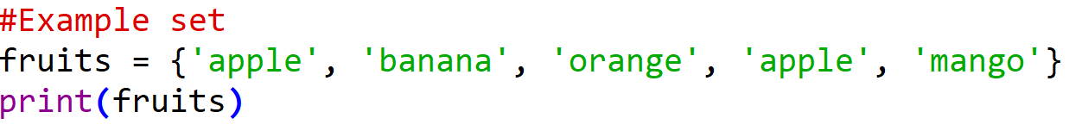
Sets – Data Type Example

Slide 16
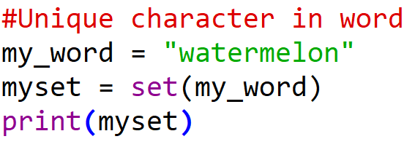
Sets – Function Example

